Slide 1
Mary Olson, Director
www.genderandradiation.org

Slide 2
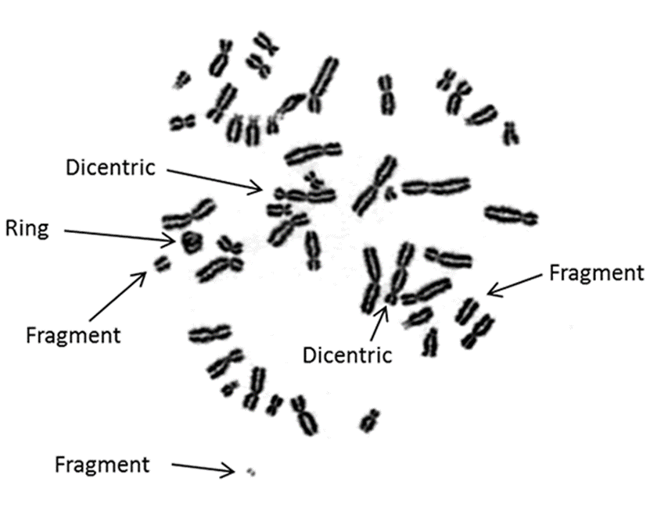
Radiation Induced Chromosomal Aberrations, as seen with microscope
Notes:
Radiation is invisible but we can see the damage it has done to these chromosomes.
***
Resources:
Dicentric and other chromosomal aberrations are common in people who have suffered acute radiation exposure. The damaged chromosomes are found in white blood cells and can be assessed as a biological dosimeter. More information here:
http://www.rerf.jp/radefx/late_e/chromoab.html

Slide 3
Ionizing Radiation:
Non-Cancer Medical Impacts
Most catastrophic reproductive impacts of radiation exposure will be loss of pregnancy so early it is only detectible as infertility
Notes:
Radiation impacts our cells.
When the reproductive cells are harmed, deformations are one outcome.
This happens to all babies: plants, animals, humans.
We also suffer:
Loss of fertility;
Spontaneous abortion and miscarriage;
Possible heritable mutations;
Avoidance of reproduction due to uncertainty.
***
Resources:
Impact on radiation exposure on reproduction has been very difficult to study in human beings. The work of Moller and Mousseau on species with a shorter life span (birds, bugs, plants) shows that ionizing radiation does reduce population size, results in mutations that are heritable and that some of the mutations are expanding in populations outside the initial study areas near Chernobyl and Fukushima. See:
http://www.academia.edu/1376987/Abundance_of_birds_in_Fukushima_as_judged_from_Chernobyl and:
http://cricket.biol.sc.edu/chernobyl/papers/moller-et-al-Ecol-Ind-2013.pdf
Radiation exposure can also lower our overall immune function, leading to many symptoms like increases in other illness, chemical intolerance and in the extreme and AIDs-like syndrome.

Slide 4
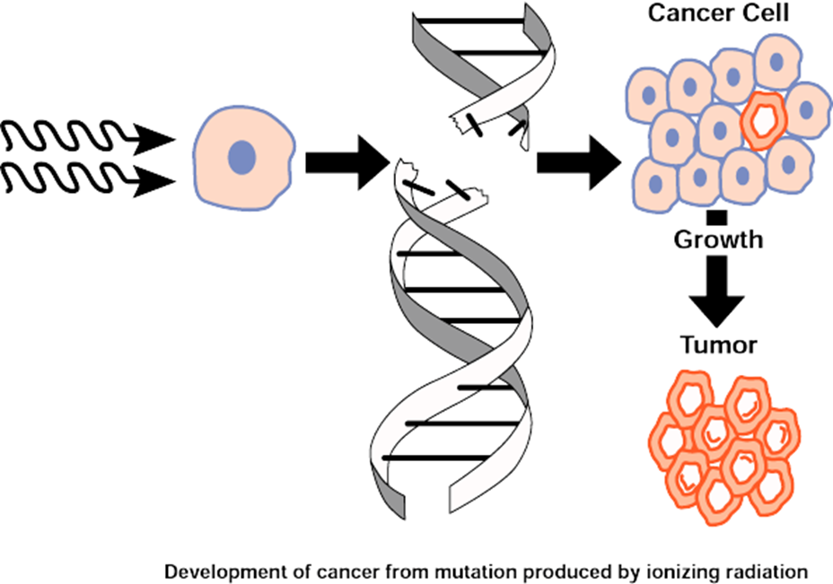
Medical Impacts of Ionizing Radiation:
Cancer
Notes:
Cancer is the most studied long-term consequence of non-lethal radiation exposure.
WHEN genetic material inside a living cell is damaged, sometimes our bodies can repair that damage. Otherwise the abnormal cell may sit quietly in the body for years or even decades before it makes us sick.
There is no way to predict which exposure will result in cancer. In general, more radiation equals more cancer risk. However, even an exposure too small to measure could, sometimes, result in cancer death.
***
Resources
Previous pages have listed some of the classic authors on radiation of the 20th century. The National Institute of Environmental Health in the United States published this broader piece “Cancer and the Environment: What You Need to Know.” posted:
http://www.niehs.nih.gov/health/materials/cancer_and_the_environment_508.pdf

Slide 5
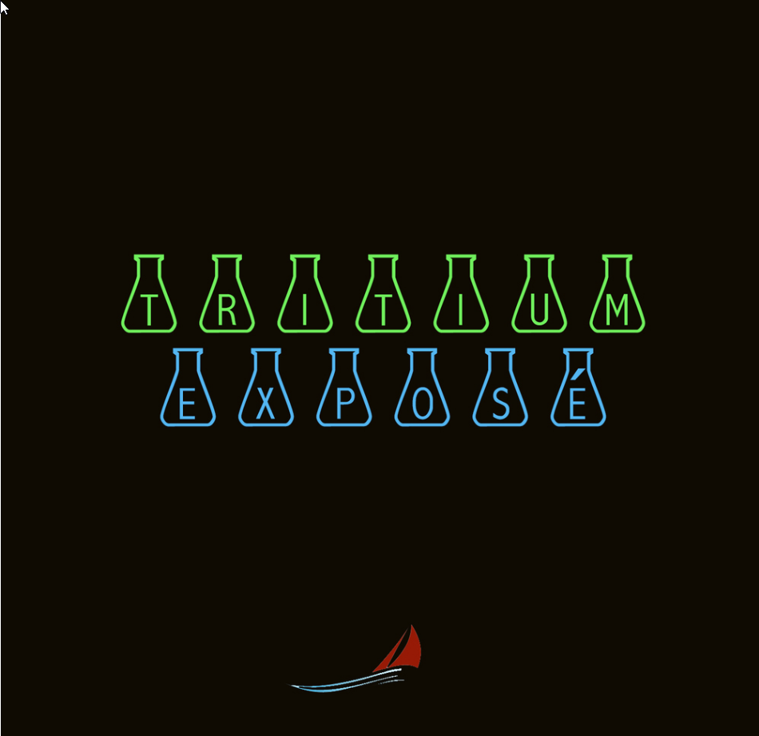
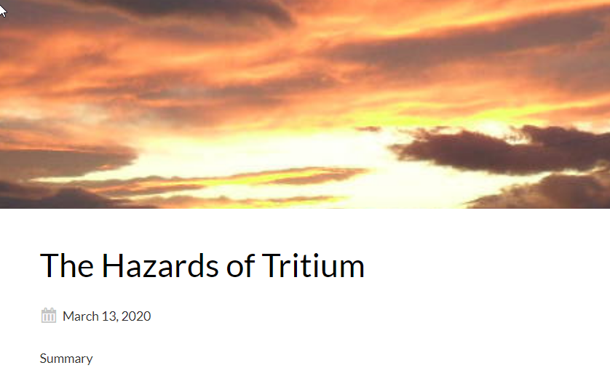
Dr Ian Fairlie
https://www.ianfairlie.org/news/the-hazards-of-tritium/
Arnie and Maggie Gundersen
https://www.fairewinds.org/podcast/tritium-expose

Slide 6
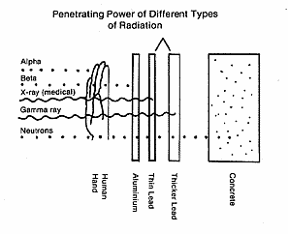
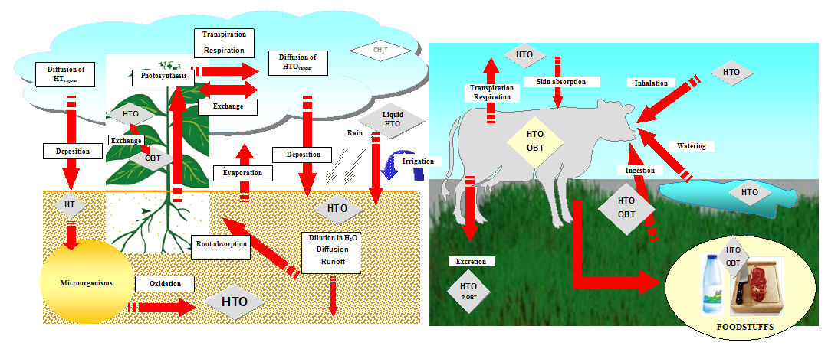
Tritium: External exposure / consumption and Internal exposure
Bio-accumulation into our food where Tritium’s beta particles are much more damaging

Slide 7
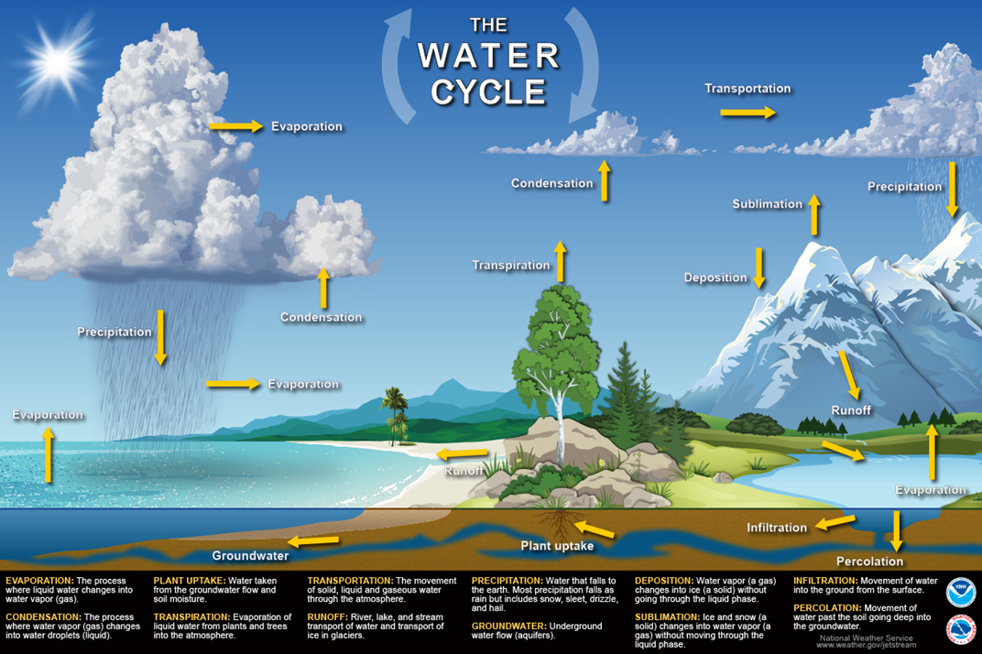
Tritium moves as Radioactive Water
Any “H” could be Tritium = radioactive water
Half-life = 12.33 years
Hazard = 10—20 times

Slide 8
Tritium can bind into DNA molecules—its decay product, Helium cannot
Tritium decays to Helium by spitting out a beta-particle
The Beta comes flying out of the Tritium nucleus it is moving fast—it has energy
Beta particles can break DNA strands and other cellular structures
The Tritium atom is gone and NOW there is a helium atom instead--radioactive decay wreaks biochemical havoc
Tritium is a BAD-ACTOR – and should not be dismissed

Slide 9
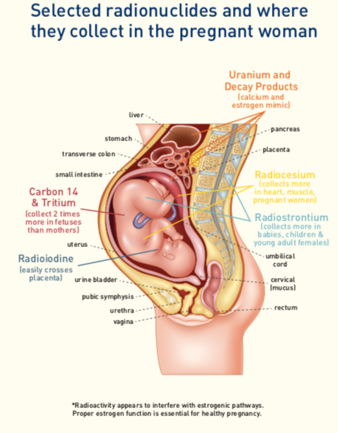
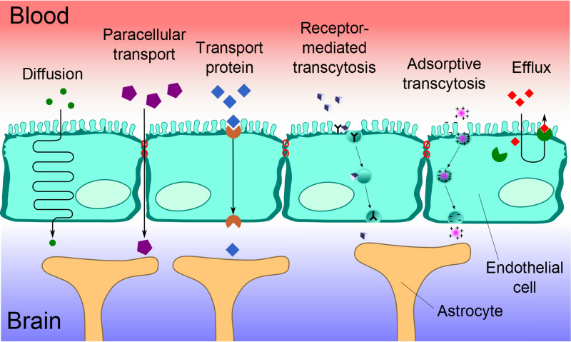
Water goes anywhere: Across the blood / brain barrier to the brain
Radioactive water moves just like ordinary water—and half will exit the body within 10 days after entry
Across the placental barrier to the fetus
(Image: Beyond Nuclear International)

Slide 10
Tritium can also be—organically bound into things besides water
Tritium will “sub” hydrogen in many biochemicals including:
proteins
nucleic acids (including DNA)
Carbohydrates
Bound tritium stays in body longer compared to intake of radioactive water. Longer means more radiation so total exposure from bound Tritium is about twice that from consuming tritiated water.
Bound Tritium increases the likelihood of harm from decay

Slide 11
How does Tritium get out of a reactor?
Routine venting
Leaking out of fuel pool and pipes
Every time the Reactor Vessel is opened for refueling or any other reason releases massive clouds of radioactive water vapor off-site
Planned dumping
Unplanned dumping (spills)
Dr Ian Fairlie has testified that women who are pregnant—or want to be—and children should not live within 10 miles of a nuclear reactor because of ongoing Tritium hazards

Slide 12
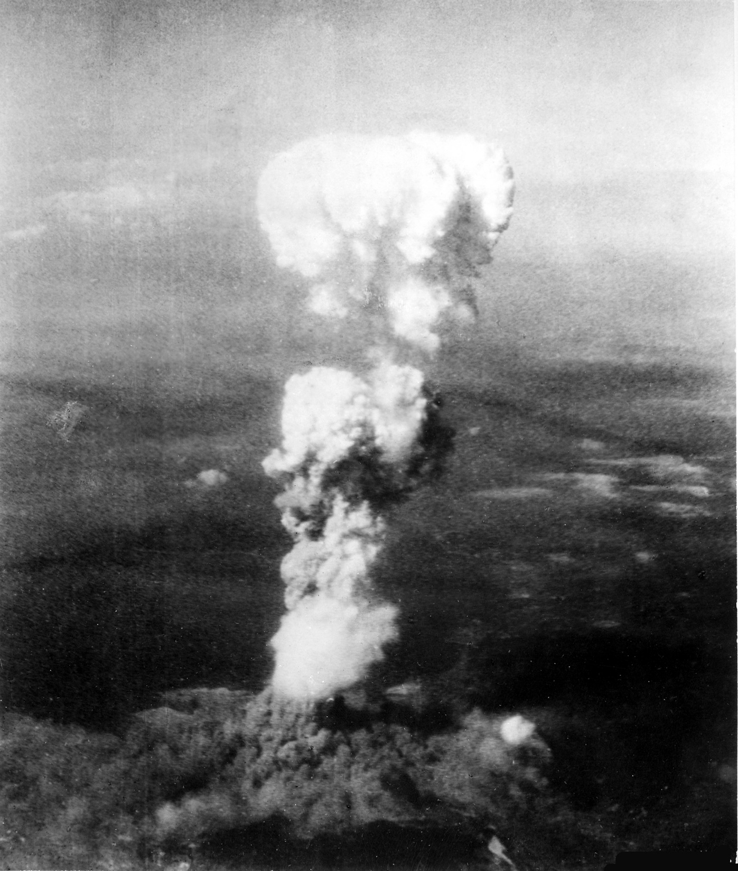
Notes:
This photo was taken from the plane that dropped the bomb on Hiroshima.
It is a mistake to say that this photo is of the bomb.
This cloud is what was, moments before:
buildings,
trees,
homes,
girls,
boys,
women and men.

Slide 13
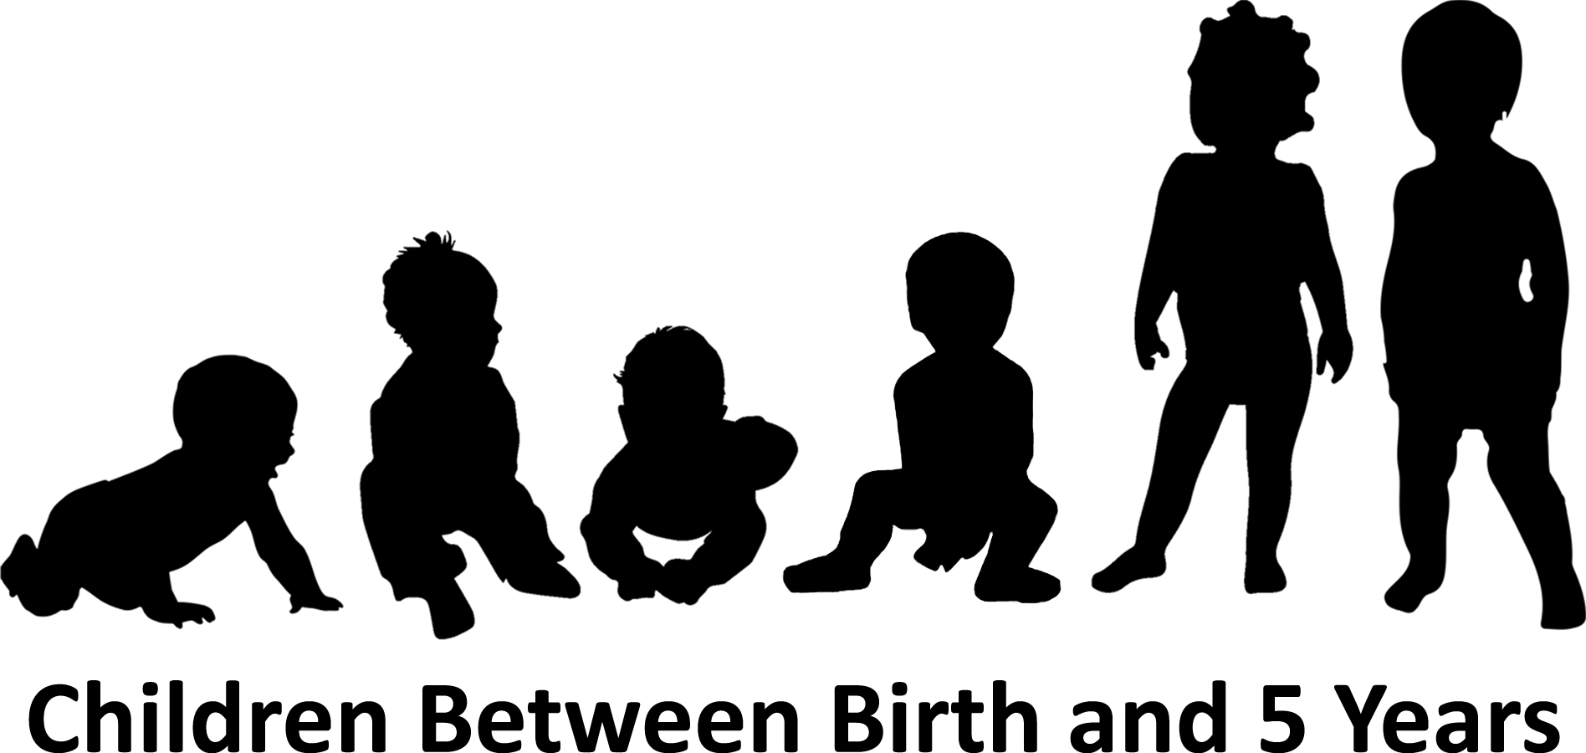
Radiation is more harmful to children
Notes:
Children’s bodies are small; so the same amount of radiation delivers a larger dose.
Since children are growing, the cells in their bodies are dividing more rapidly. The DNA in cells is more likely to be damaged when in cell division.
Understanding that we as a species—humans—have a lifecycle is fundamental to understanding the significance of what I am about to tell you:
We need to understanding that what happens to our bodies in childhood may impact our health and disease for the rest of our lives.
***
Art Credit:
Saro Lynch-Thomason, Fullsteam Labs

Slide 14
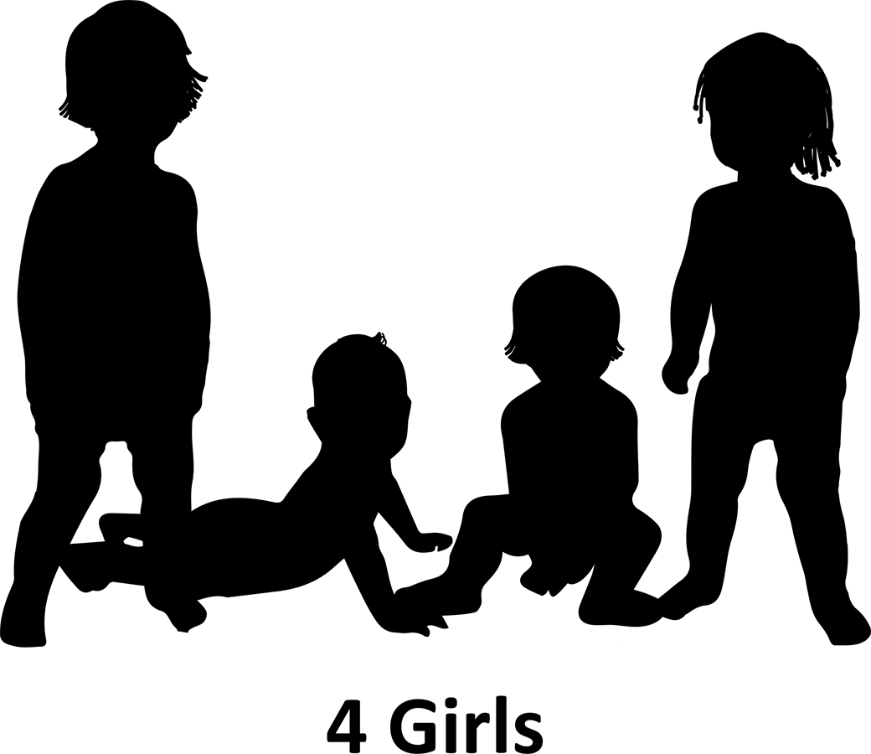
Lifetime Risk of Cancer Incidence (acute exposure between birth and age five)
Notes:
The survivors of Hiroshima and Nagasaki were grouped by the age they were at the time of the bombing. These groups were tracked over their lifetimes. Cancers and cancer deaths were counted.
There are many problems with this data, but we can broadly say that those who were five years or younger in August, 1945 had the most cancer at some point in their lives.
Girls in this group were twice as likely to get cancer at some point than were boys.
For every male in the 0-5 cohort that suffered cancer at some point in their lives,
two females got cancer.
The BEIR VII report is where these numbers are found; the report itself does not discuss gender as a risk factor. I first published my findings in 2011. They are an independent confirmation of the same findings published previously by Dr. Arjun Makhijani and team in 2005.
***
Source:
Olson, 2011. NIRS Briefing Paper: “Atomic Radiation is more harmful to women.” posted:
http://www.nirs.org/radiation/radhealth/radhealthhome.htm
And Olson 2019. Disproportionate impact of ionizing radiation and radiation regulation. In Interdisciplinary Science Reviews, May 2019.
Makhijani, et al, 2005. Science for the Vulnerable, part of the Healthy from the Start Campaign to address disproportionate impact of ionizing radiation on young females.
http://ieer.org/projects/healthy-from-the-start/
And http://ieer.org/resource/health-and-safety/open-letter-to-president-bush-on-protecting-the-most-vulnerable/
Art Credit:
Saro Lynch-Thomason, Fullsteam Labs

Slide 15
Lifetime Cancer fatalities among those exposed to ionizing radiation as adults
Notes:
Gender was also a factor for those who were adults at the time of the bombings.
Over their lifetime women exposed as adults suffered 50% more cancer death than did men in the same age group.
For every 2 men in these cohorts who died of cancer, three women died of cancer.
***
Source:
(see above) Olson, Makhijani, numbers in tables of BEIR VII.
Art Credit:
Saro Lynch-Thomason, Fullsteam Labs

Slide 16
Based on Table 12D-1, NAS, 2006, Biological Effects of Ionizing Radiation (BEIR VII)

Slide 17
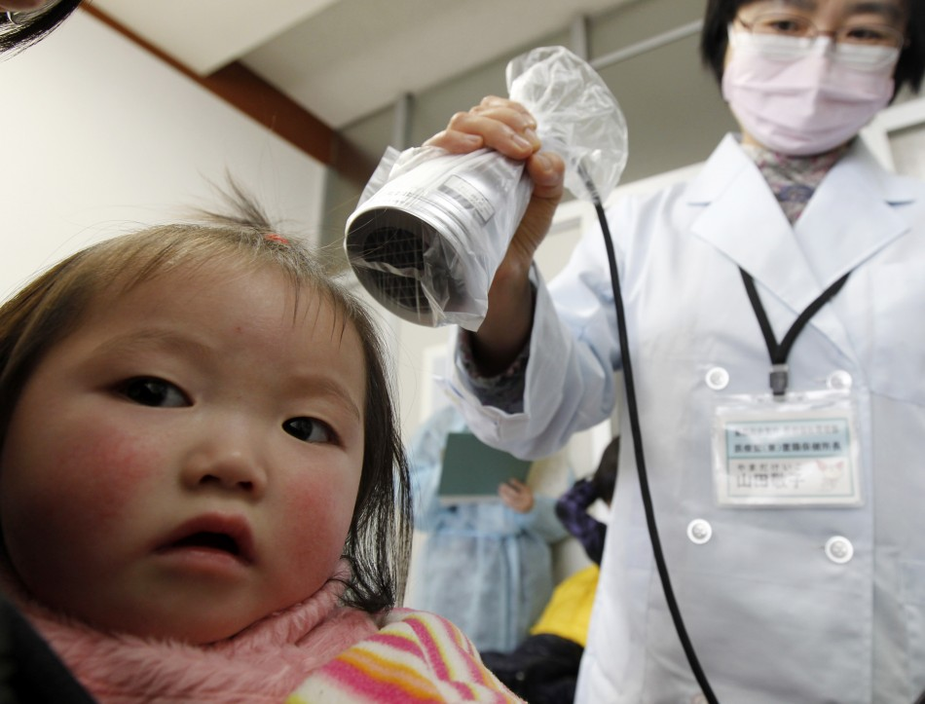
Notes:
It is extremely important to understand that little girls are not a “sub-population.”
We are an inextricable link of the human lifecycle.

