Slide 1
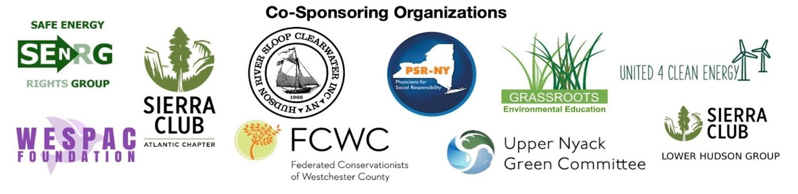
Critical Public Health and Safety Impacts of Decommissioning Indian Point • Expert Forum
Thursday, February 16th, 4:00 p.m. EST
Welcome George Latimer, Westchester County Executive
Background Dr. Courtney Williams, Cancer researcher and Co-founder of Safe Energy Rights Group (SEnRG)
Potential health impacts of environmental exposures to children Dr. Kathy Nolan
Pediatrician, President of Physicians for Social Responsibility of New York, Co-Founder of Concerned Health Professionals of New York, Ulster County Legislator.
Radioactive Fuel Pool Water Treatment System issues Arnie Gundersen
Chief Engineer at Fairewinds Associates, former nuclear industry executive
Disproportionate harm from radiation exposure tied to biological sex Mary Olson
Biologist and Founder of the Gender and Radiation Impact Project (GRIP)
Notes:
Goal for today: Arm you with knowledge for advocacy and to combat complacency
We have DOB, but with no medical/health expert, no expertise on the colocation of nuclear and gas transmission lines.
This forum fills the gap.

Slide 2






Who am I? Why am I here?
www.ResistSpectra.org
facebook.com/ResistAIM
Twitter: @ResistAIM
ResistAIM@gmail.com
www.SAPE2016.org
facebook.com/groups/sape2016/
Twitter: @SAPE2016
www.SEnRGorg.com
facebook.com/SEnRGorg
Twitter: @SEnRGorg
Notes:
Two vignettes for why YOUR advocacy is critical

Slide 3
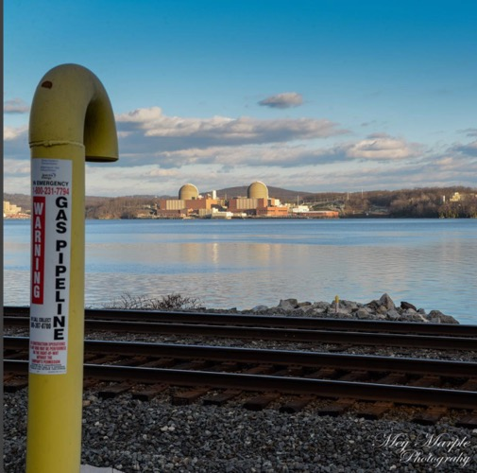
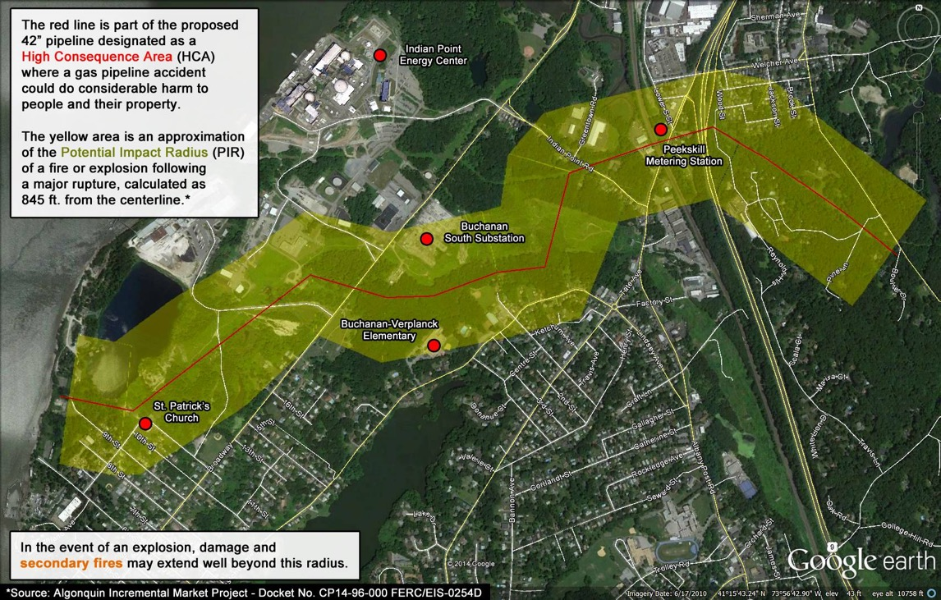
Background: The “Algonquin” Pipeline System runs multiple high-pressure gas pipelines across the
Indian Point Nuclear Site
Notes:
Tombstone Regulation

Slide 4

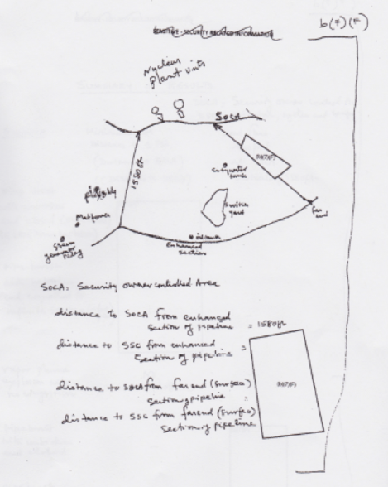

How did we get here? Thanks to the NRC and FERC
FERC=Federal Energy Regulatory Commission
NRC=Nuclear Regulatory Commission
Source: Nuclear Regulatory Commission, FOIA

Slide 5
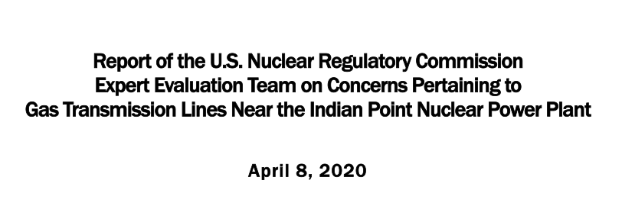
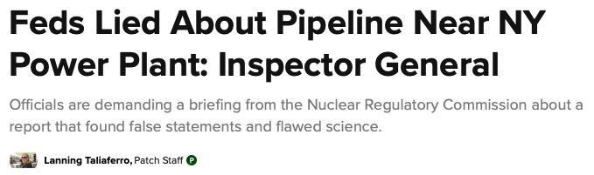
NRC Office of the Inspector General’s Investigation:
NRC Conducted a Faulty Analysis
“OIG learned from Enbridge that it would, in fact, take the pipeline operators a minimum of 6 minutes after a leak is detected to manually close the isolation valves and thereby stop the flow of gas into the ruptured portion, and not 3 minutes as NRC claimed to have calculated using ALOHA. Enbridge also told OIG that if there were an explosion near IPEC, operators would shut valves that were approximately 14 miles apart rather than 3 miles apart as NRC assumed in its analysis.”
“NRC’s underlying independent analysis was conducted using a computer program [ALOHA] that the NOAA, which developed the program, said it was not designed for.“
“[NRC analysis] appeared to be backwards engineering to get a desired result.”
“NRC’s independent analysis was incorrectly portrayed in FERC’s approval document as significantly more conservative than it actually was.”
“NRC’s inspection report contained inaccuracies suggesting additional analysis had been conducted, when this was not the case.”
Notes:
10 C.F.R. 50.59 Safety Evaluation and Supporting Analyses Prepared in Response to the Algonquin Incremental Market Natural Gas Project Indian Point Nuclear Generating Unit Nos. 2 &3
Docket Nos. 50-247 and 50-286
License Nos. DPR-26 and DPR-64

Slide 6
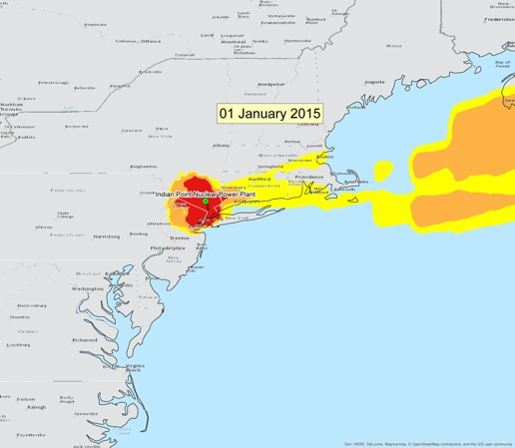
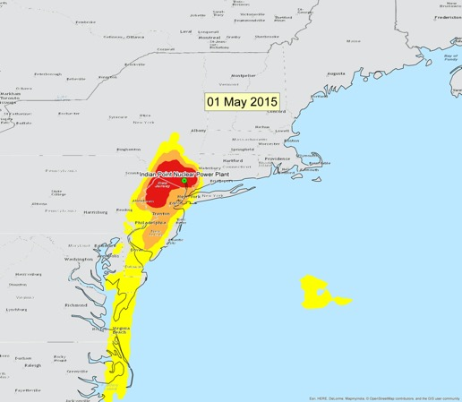
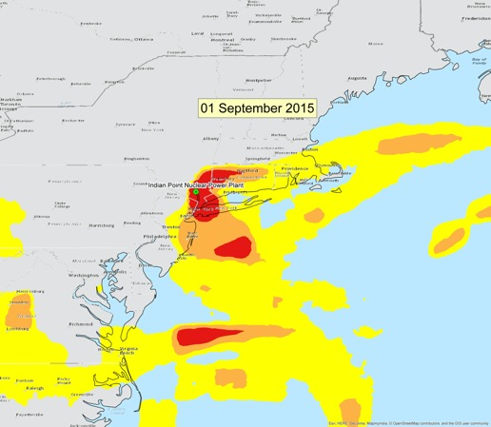
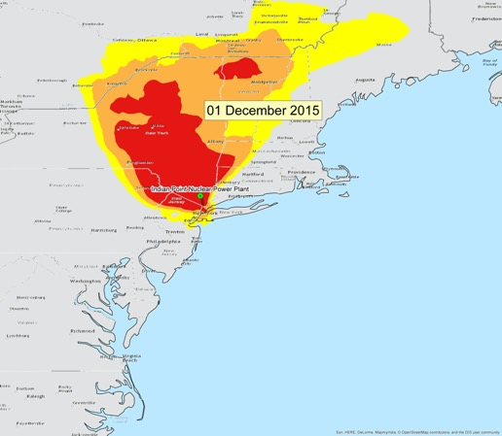
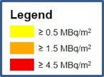
Princeton University Program for Science and Global Security:
NRC underestimates potential for nuclear disaster
Source, Personal Communication:
Frank von Hippel*, Michael Schoeppner*, and Edwin Lyman**
*Program for Science and Global Security, Princeton University
**Union of Concerned Scientists
Peer Reviewed Analysis “Nuclear safety regulation in the post-Fukushima era,” was published May 26, 2017 in Science
Lay article: “Spent fuel fire on US soil could dwarf impacts of Fukushima: New study warns of millions relocated and trillion-dollar consequences”– Science May 24, 2016

Slide 7
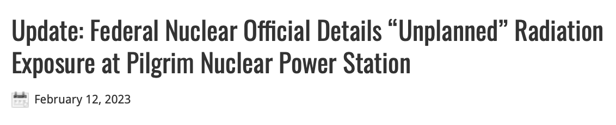
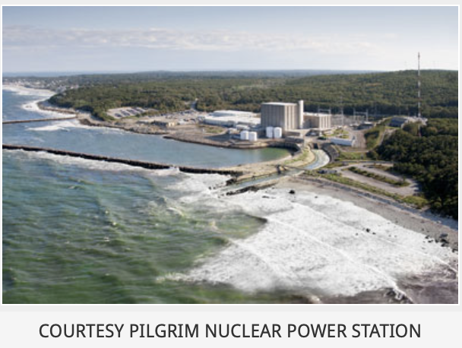
August 2020, 6 workers contaminated, Cs-137 found on roof
November 2022 incident recorded in NRC Inspection Report
February 8, 2023 Inspection Report made public
Notes:
Hope these two vignettes have driven home the need for your advocacy and action. Because we need you.
In all honesty, it was hard to pick. When Holtec got canister stuck 18 feet in the air and then didn’t report it to NRC? When Holtec changed a procedure without getting NRC approval and a worker at Oyster Creek was contaminated with radioactive water? The decades of radioactive water leaking from under IP into the Hudson? The detection of radionuclides in a trial of desalinization for drinking water in Rockland? The fires? The degradation involving about 227 baffle bolts, which amounted to some 25 percent, the highest percentage ever found at a U.S. nuclear plant at that point? Whistle blower reports?
List goes on and on. Bottom line is that we cannot be complacent. The NRC does not provide the oversight the public thinks it does. The agencies on the DOB- DEC, DOH, DPS- alphabet soup of agencies that are restrained by complacency and bureaucracy.
But in every single case- the underlying cause was greed. Putting profits ahead of worker safety, public safety.
6 workers contaminated with assortment of radionuclides
process “posed a significant potential to spread high levels of loose surface contamination.”
2 workers contaminated, no correction led to 4 more being contaminated a week later
Holtec was in violation of an NRC code because it didn’t implement air sampling in an area where workers were using respiratory protection and being decontaminated.
Holtec’s whole-body counter at the decommissioning site was not operating at full capacity, missing components, no worker qualified to operate it, no backup if it broke down
“inappropriate” plans to use routine drug screening equipment for detecting internal radioactive doses in staff urine samples.
Cesium-137 detected in four samples of sediment on trash compactor roof
https://www.capecod.com/newscenter/report-says-holtec-workers-exposed-to-unplanned-radiation-intake/?fbclid=IwAR2rZQyH45Z7z3wvslDOtA6ICkXItPV45zahaiJjgU60GIGxv_gl1eavKs0

Slide 8


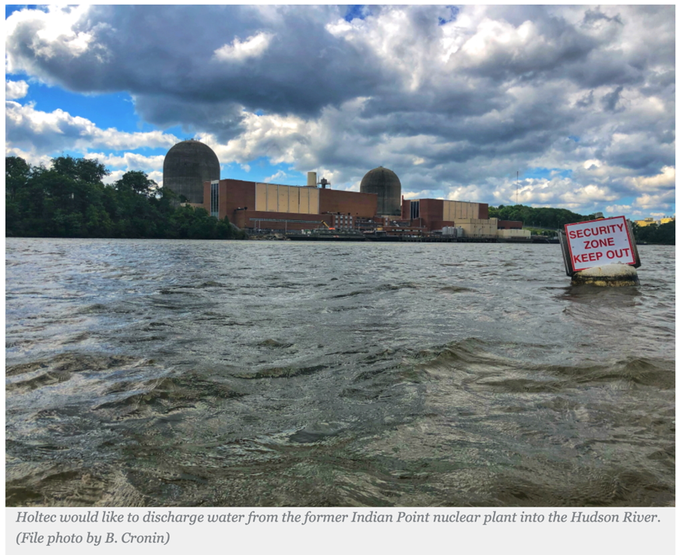
Notes:
Currently DOB has no health/medical expert. So next we have presentations from
Potential health impacts of environmental exposures to children Dr. Kathy Nolan
Pediatrician, President of Physicians for Social Responsibility of New York, Co-Founder of Concerned Health Professionals of New York, Ulster County Legislator.
Radioactive Fuel Pool Water Treatment System issues Arnie Gundersen
Chief Engineer at Fairewinds Associates, former nuclear industry executive
Disproportionate harm from radiation exposure tied to biological sex Mary Olson
Biologist and Founder of the Gender and Radiation Impact Project (GRIP)

Slide 10
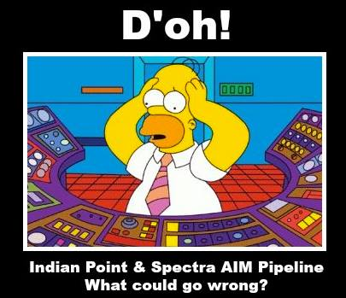
Questions?

Slide 11
Take home lessons
Legal ≠ Safe
Legal limits are based on outdated science (healthy, white male)
Legal limits set according to industry capabilities NOT public health/safety
Feasible alternatives to dumping exist
Holtec is motivated by profit, not public good
Once this water is dumped, we cannot undo it
You must take action.
All materials can be found at www.grassrootsinfo.org/indianpointforum

Slide 12

Protect our health.
Stop the discharge of contaminated water from Indian Point Nuclear Power Plant!
Call Governor Hochul (518) 4748390
Call Senator Schumer (202) 224-6542 (DC); (212) 486-4430 (NY)
Call Senator Gillibrand (212) 688-6262 (DC); (202) 224-4451 (NY)
Call your State Legislator and Assemblymember
  https://openstates.org/ny/legislators
Advocate for your municipality to pass a resolution opposing Holtec dumping radioactive wastewater into the Hudson River.
www.grassrootsinfo.org/indianpointforum
Hendrick Hudson School District Residents contact
NYS Commissioner of Education Dr. Betty Rosa
(518) 474-3817
betty.rosa@nysed.gov
RegentRosa@mail.nysed.gov
Notes:
You are doing action steps. Call state legislator (will get links) Call Schumer and Gillibrand (will provide numbers) Call Gov Hochul (Number) Tell them to protect our health and environment and prohibit Holtec from dumping radioactive wastewater from Indian Point into Hudson River. Advocate for your municipality to pass resolution opposing Holtec dumping radioactive wastewater into Hudson River. Go to forum web page www.grassrootsinfo.org/indianpointforum for a sample resolution and have your municipality advocate/send to county, state and federal electeds and local, state and federal govt agencies: EPA REGION 2, NYS DEC, NYS DOH, NYS LEGISLATORS, etc. Anywhere else?

Slide 13
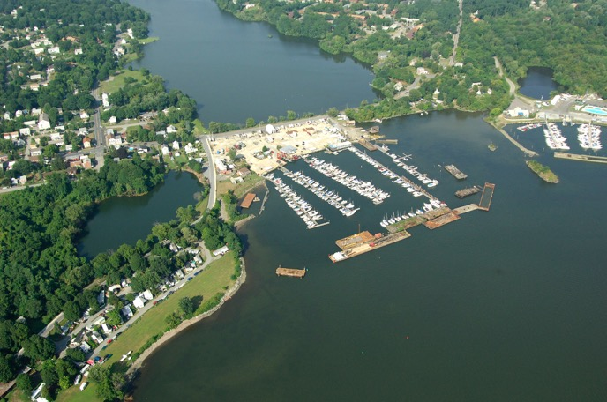
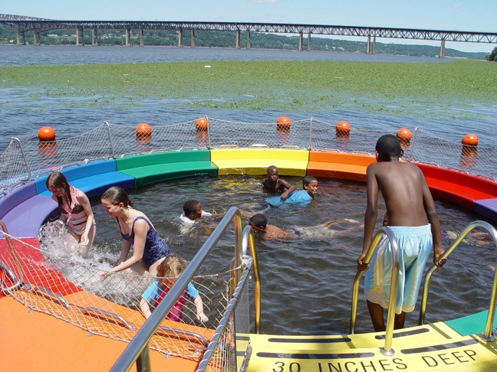
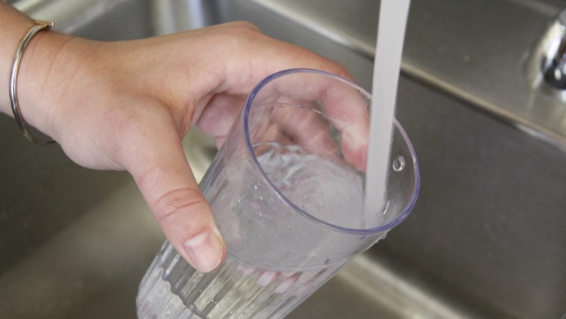
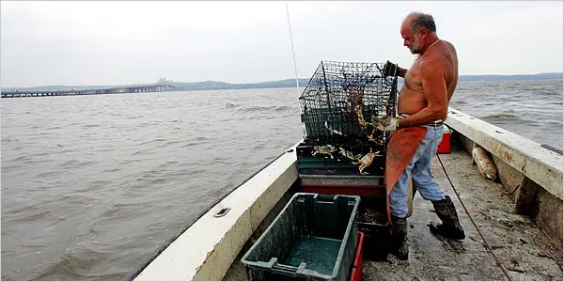
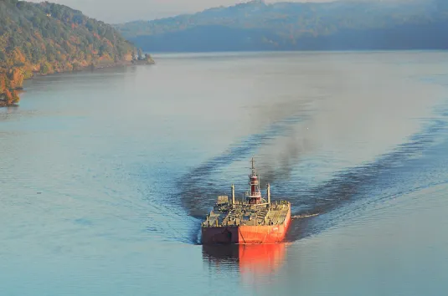
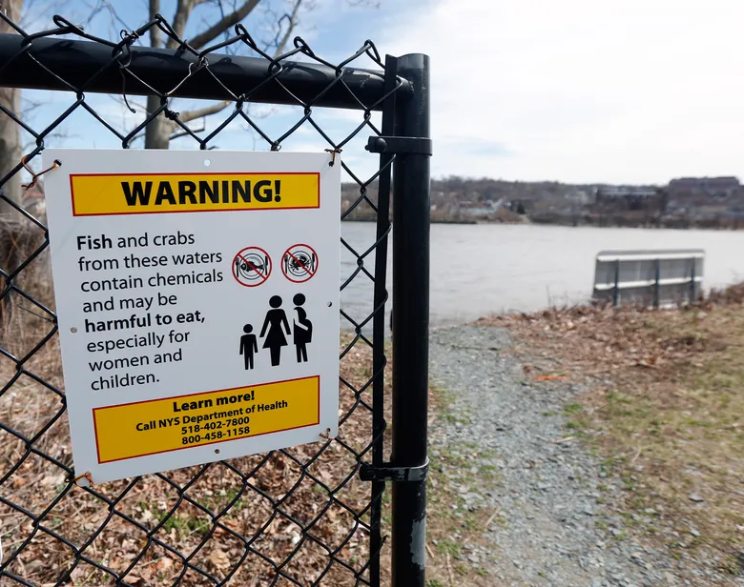
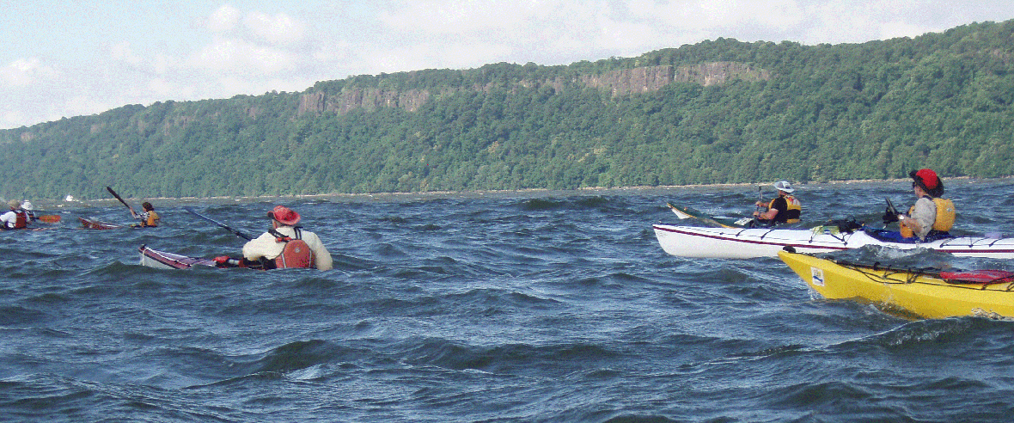
Source: Marinas.com
Source: New York Times
Source: Poughkeepsie Journal
Source: Dutchess Tourism
hudsonrivergreenwaywatertrail.org
Source: Seattle Times
Source: The Daily Freeman

