Slide 1

Citizen monitoring at Peach Bottom & Three Mile Island
Settlements with AmerGen, Exelon, FirstEnergy & GPU Nuclear

Slide 2
air emissions standards for TMI
On September 22, 1983, Dauphin County Commissioners passed a resolution to establish air emissions standards for TMI. The county also established a task force to write the ordinance. This is the first time a county takes legally binding action to control the hazards caused by nuclear power operations.
The Clean Air Ordinance was never implemented.

Slide 3
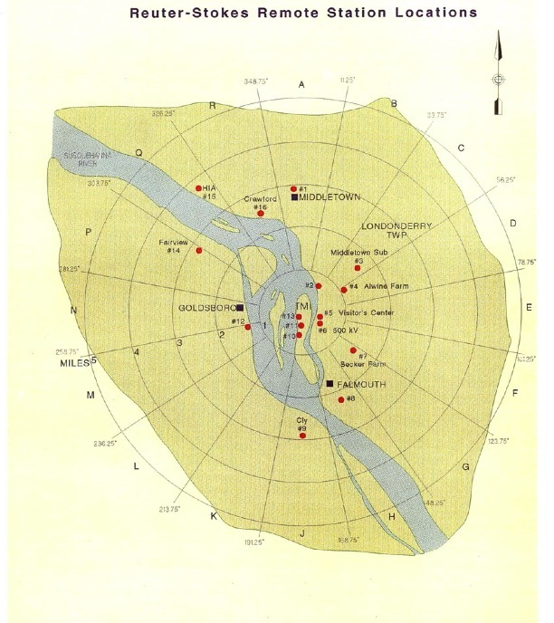
Real Time Gamma Monitoring
TMIA partnered with Dauphin County Commissioners and GPU: Reuter-Stokes Real Time Gamma Monitoring.
Sixteen stations around TMI.
Print out in Courthouse, and sensitive enough to detect laundry shipments and very active during defueling.

Slide 4
1992:
Comprehensive TMI-2 settlement
Included:
Information exchange
POL
On-line access to Reuter-Stokes
Regular meetings
A Remote Temperature Detector.
Archives and oral histories stored at Dickinson College.

Slide 5
EFMR created
EFMR was created.
Held “Rad Alert” Training at Dickinson College with the Department of Physics and Astronomy annually for ten years.

Slide 6
monitors deployed
60 out of 75 monitors deployed
Hand held monitors with self reporting.
Monitors deployed to a wide cross-section of the community. All actively involved in gathering daily radiation data.
  Individuals
  High schools
  Colleges
  Community-based organizations
  Plant workers
The collected data is forwarded to the Dickinson College Department of Physics and Astronomy which has been responsible for compiling and analyzing the data for more than a dozen years.

Slide 7
Controversial partnership with Dickinson College
Created manual for three hour trainings at Dickinson College.
Dickinson lab built with funding from GPU.
Dickinson students collected samples from Low-Volume Air Samplers.
Third party agreement for fees and stipends for quarterly and weekly readings.

Slide 8
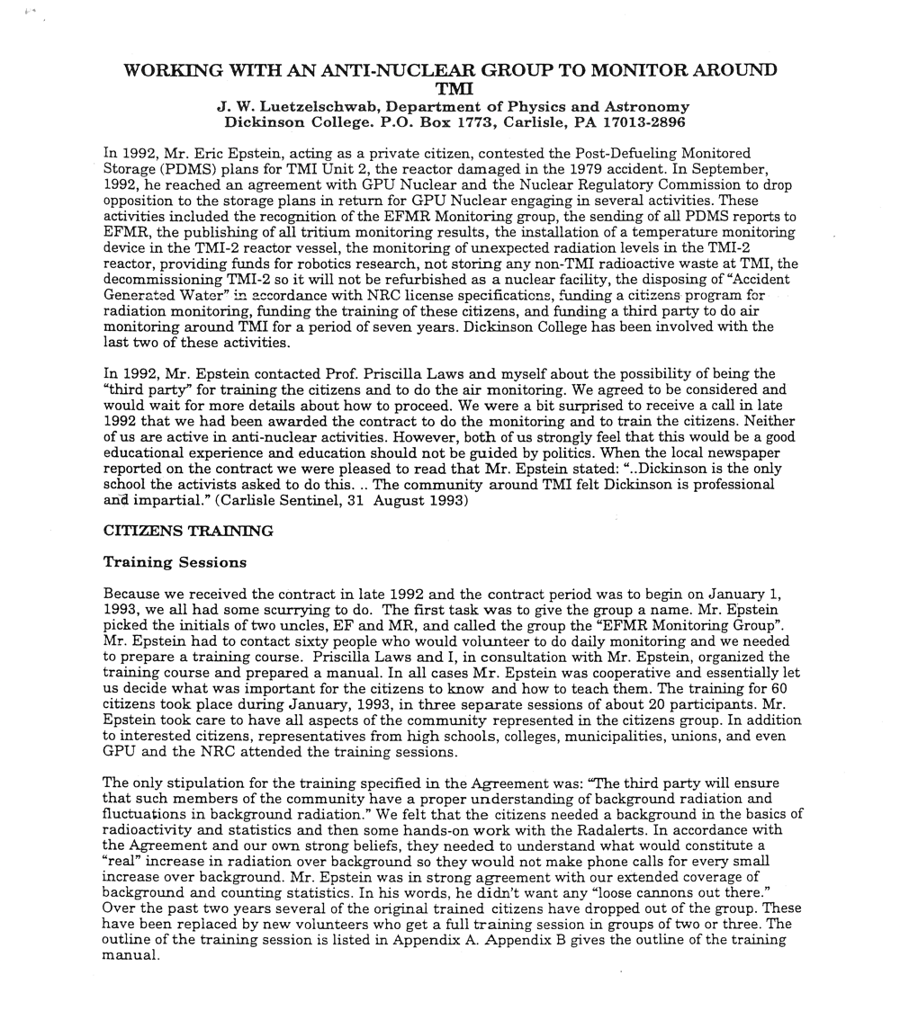
Challenges
Attitudes
Calibration and 30 cpm
Data and information gathering
East and West Shore biases
False positives
Filter exchange for five low volume air samplers on goat farm
No municipal readings
Noise
Nuclear medicine
People move
Radon masking
Timeliness
Weather

Slide 9
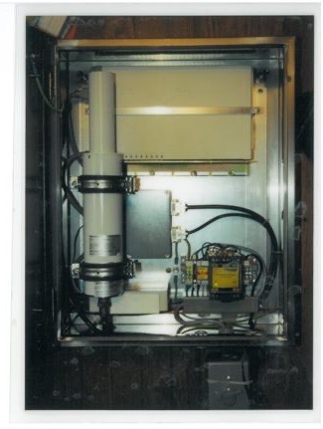
Transition
EFMR secured five Thermo Eber- line monitors and strategically placed them in the area around Three Mile Island.
Based on careful study of population concentrations and prevailing wind currents, five monitors were located in:
  Etters
  Lower Swatara
  South Harrisburg
  Yocumtown
  Harrisburg International Airport

Slide 10
new monitors
The new monitors had a series of gamma dose rate detectors which use the NBR (National Background Rejection) method to discriminate between normal background gamma radiation and other sources of radiation.
This clearly indicates whether an increase in radiation was due to artificial sources in the environment or merely a normal, natural event due to changes of weather, temperature, or rain.
These devices are ideally suited for environmental monitoring.

Slide 11
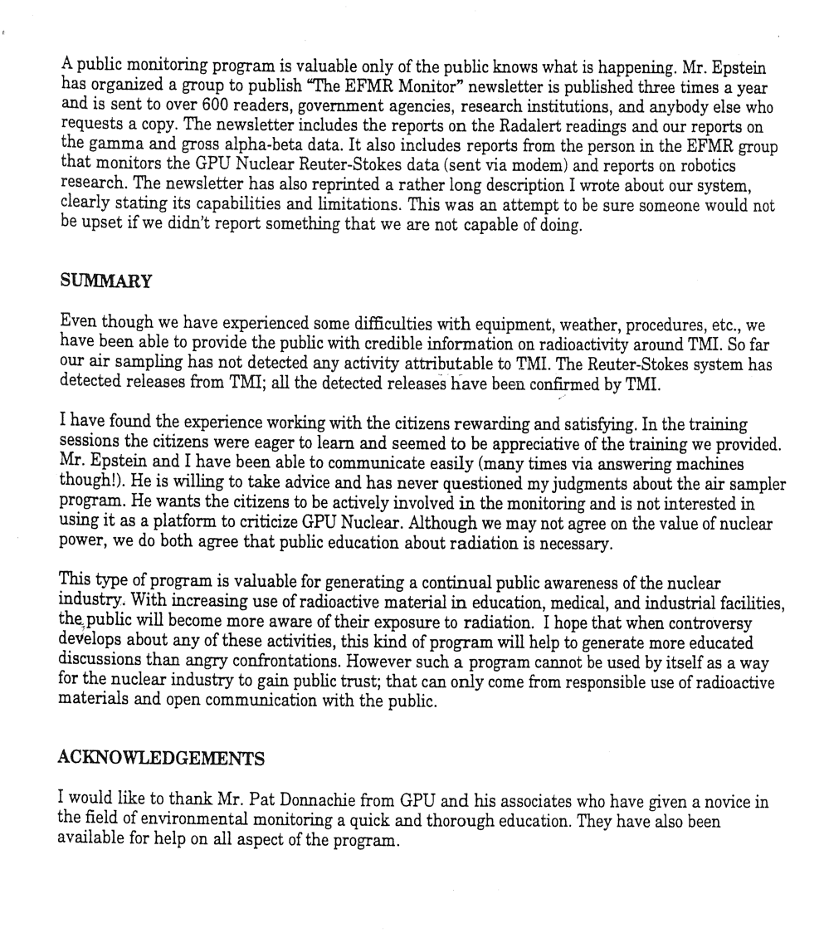
challenges
Bad equipment and poor support from Thermo-Eberline.
German and metric standards created software conversion challenges.
Five separate phone bills and zoning hurdles.
There were making issues from the Incinerator and steel mill.

Slide 12
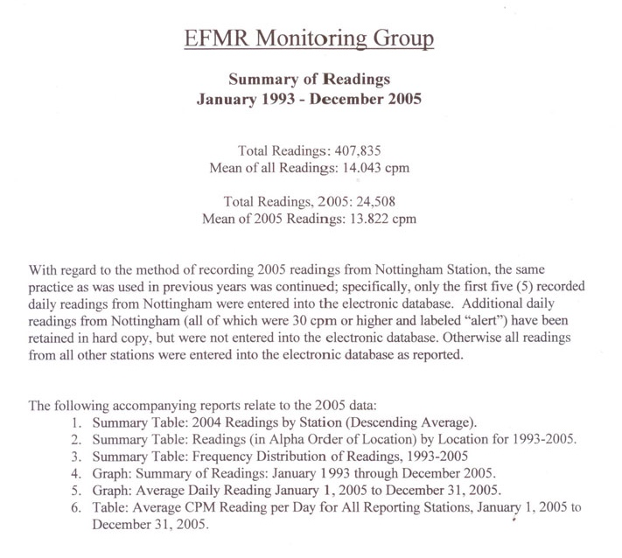
Exelon Agreement in 2008
EFMR staff created real-time monitor.
No regulatory real-time, off-site monitoring.
No phone lines and part-time computer technician.
Staff had worked at Peach Bottom, Saxton or Three Mile Island.
Citizen real-time monitoring with ST-10.
Remote data retrieval.
Locations based on population and wind rose.

Slide 13
Challenges
Aging volunteer base
Data overload
Funding
Lack of support
Nuclear support
Site visits

Slide 14
